Slide 1
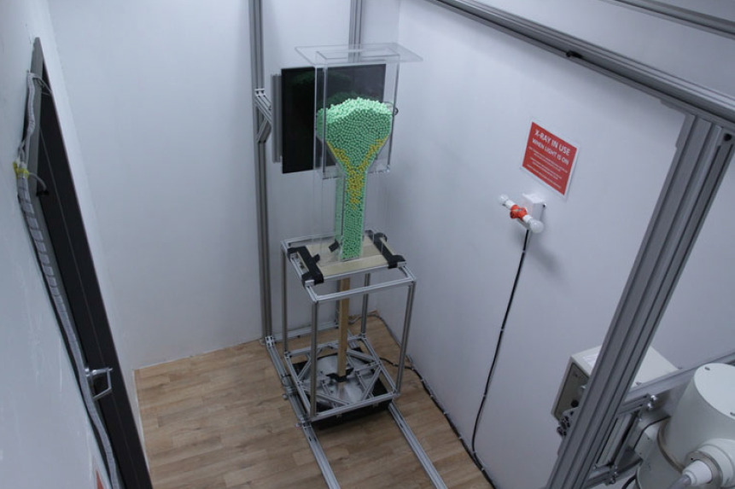
XPREX Facility Description and Users Manual
July 15, 2015

Slide 2
Outline
X-Ray Acquisition and Controls
LabVIEW Control VI
DAQ Devices
Automation
Turntable
Paintball Hopper
Linear Actuator
Installation Procedures

Slide 3
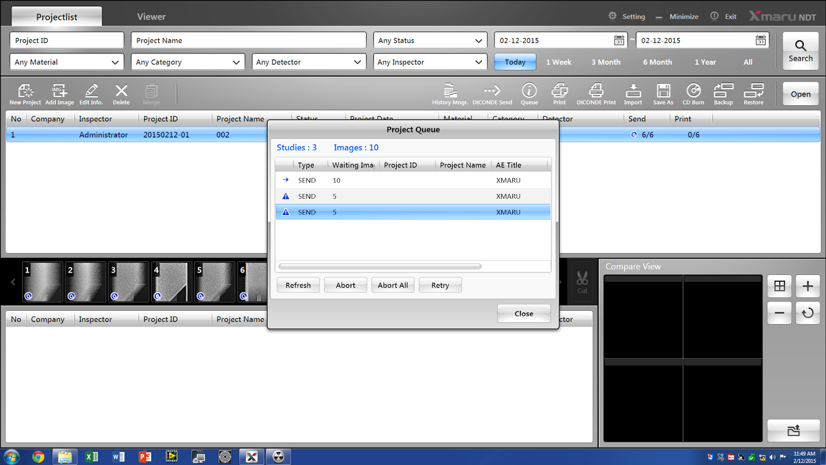
Xmaru Software
Computer PW: rayenceusa
Xmaru PW: 1234
This software is very straightforward
Main bug that you need to be cautious of:
In the past, after closing a study, the software has had a problem “dicom sending” the images. The study gets stuck in queue:

Slide 4
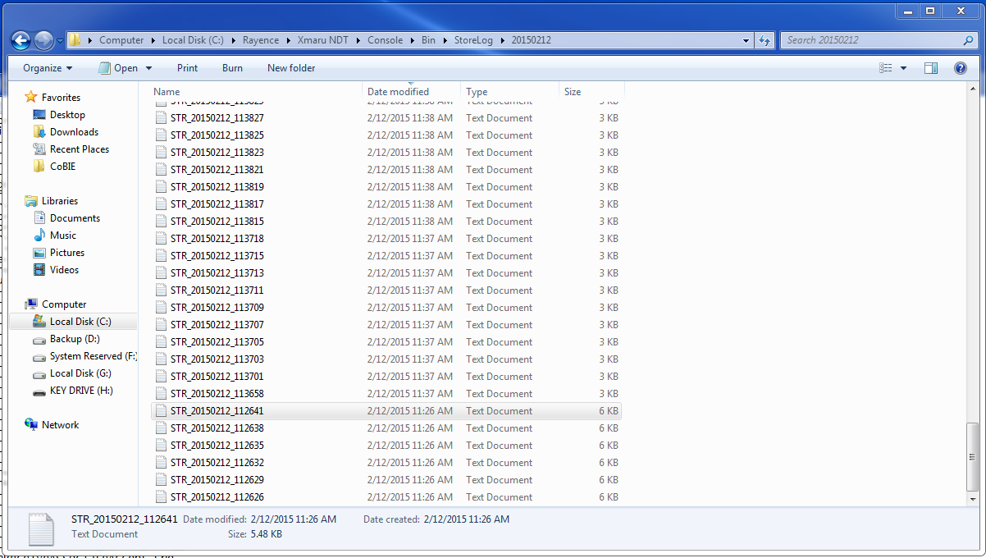
Xmaru Software
If this error occurs you can find the log of what the software did in the following folder:

Slide 5
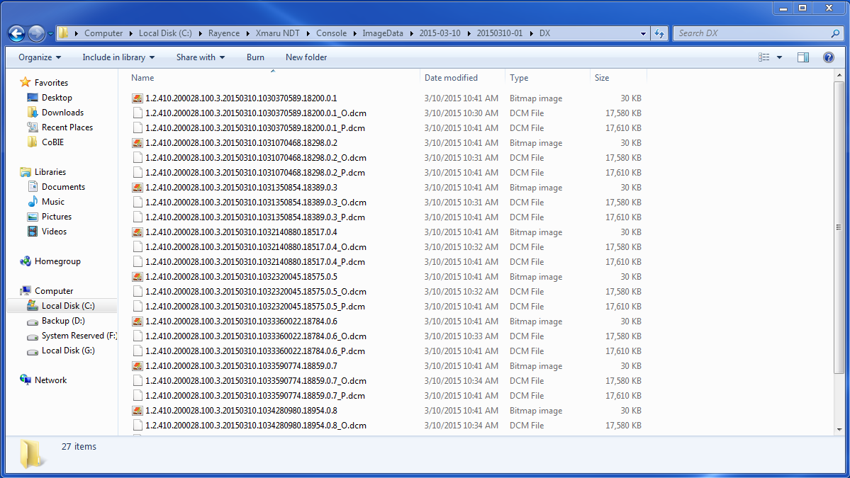
Xmaru Software
If the software errors out while sending the dicom images, you can still find the originals in the following database folder:

Slide 6
Xmaru Software
If you get a dicom send error and try to recover the original images, you may have problems with exposure and Xmaru’s image processing. Therefore, it is always better to avoid the error and export using Xmaru’s integrated features.
The main way to avoid the error has been the following:
Open your study, take your first x-ray
Close the study
You should see the image processing being applied to your image and also the progress of the dicom send
The study should appear in the list of today’s studies
If it does, you’re in good shape and we’ve never had errors in the study after that
If it doesn’t, you’ve lost one image, no big deal, restart the software and try again
The bug is only disastrous when you have completed 100 images, close the study, and all of them cannot dicom send
Closing and reopening the study very early has always avoided this bug.

Slide 7
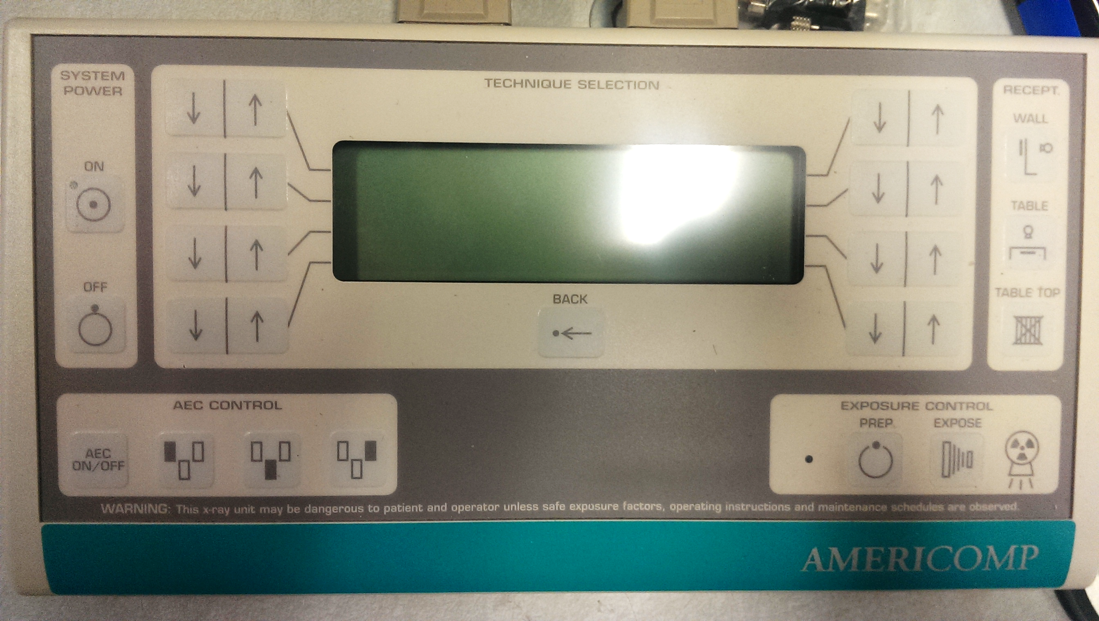
X-Ray Exposure Control
Below is an image of the x-ray controller
You should primarily learn about this in the RUA training
There is only one kink to the operation of this device that you should be aware of:
If the detector doesn’t receive full exposure, the image may have brightness/contrast inconsistencies (pretty obvious when you see it)
To avoid this: you must continue to hold down the PREP button a moment after the “ready” beeping noise, then hold down the CONTROL and PREP button together, continuing to hold for a moment even after you hear the exposure noise.
This sounds like an superfluous guide but trust me, it takes a little finesse to get a proper exposure every time
PREP
CONTROL

Slide 8
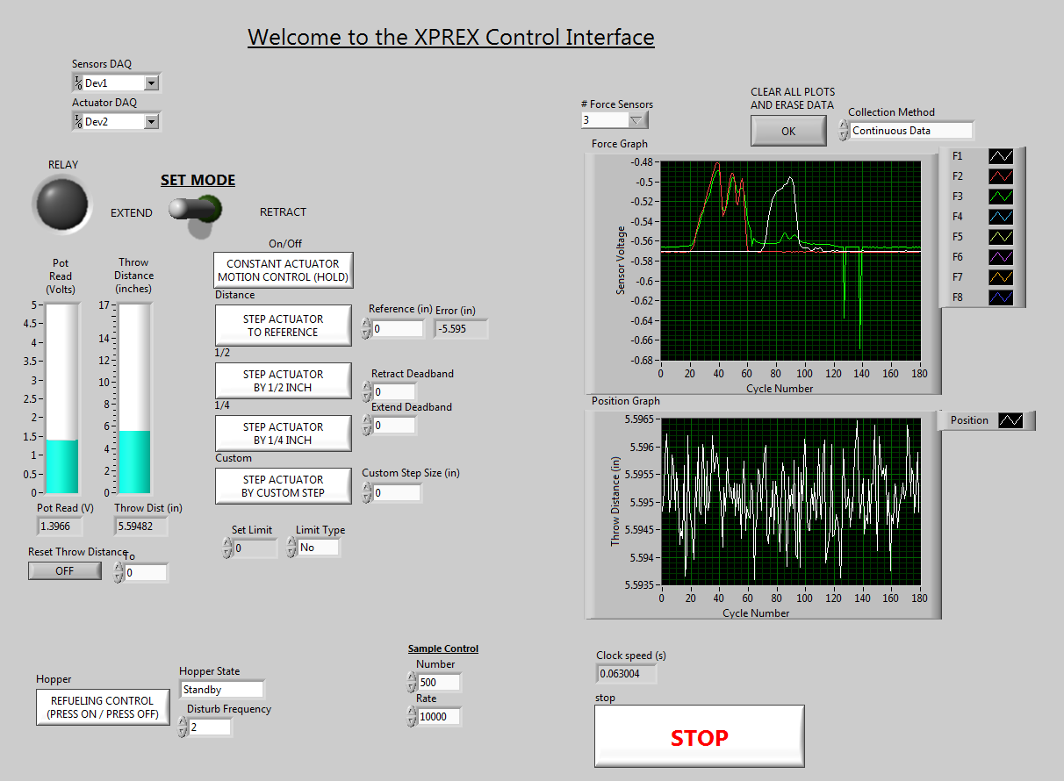
LabVIEW Control VI

Slide 9
LabVIEW Control VI
This is the base LabVIEW VI. It has one example of everything you should need.
Sensor data collection
Set DAQ Devices
Actuator Control
Actuator Position
Paintball Hopper Control
Sensor Sampling Control

Slide 10
LabVIEW Control VI
We’ll go into the actuation controls separately later.
Sensor data collection
Set DAQ Devices
Actuator Control
Actuator Position
Paintball Hopper Control
Sensor Sampling Control

Slide 11

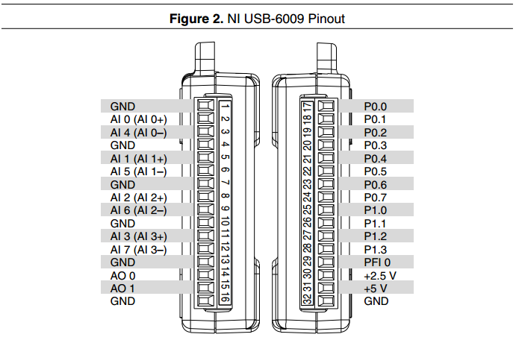
DAQ-6009
For all custom sensors and actuators, we use two National Instruments DAQ-6009 devices
http://www.ni.com/pdf/manuals/375296a.pdf
Analog I/Os
Digital I/Os

Slide 12
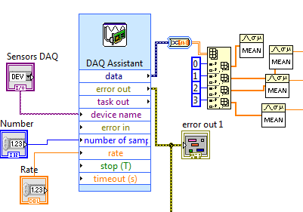
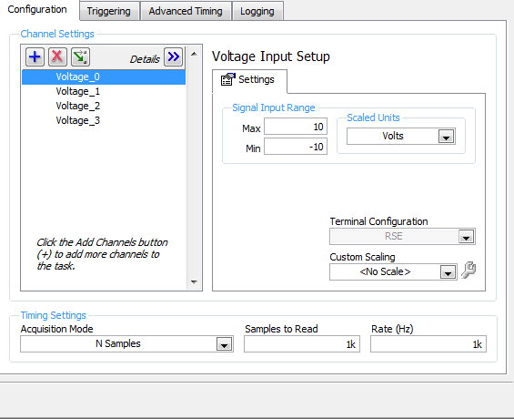
DAQ-6009
You connect to the DAQs using a standard printer (type B) usb cable
DAQ -> printer usb type B -> usb hub -> XL type B cable -> computer
Use the LabVIEW DAQ assistant express block to connect the LabVIEW VI to the DAQ.
Sensor DAQ assistant:
This is important. Use “N Samples” or “continuous”
(double click on block to see this window)

Slide 13
DAQ-6009
The DAQ records the specified “Number” of samples at the specified “Rate”, then you split the matrix and take a moving average to eliminate noise
Number
Proportional to the precision of the recorded data
Rate
How often you will record a data point
Convert to matrix
Split matrix
Take moving average
to reduce noise

Slide 14
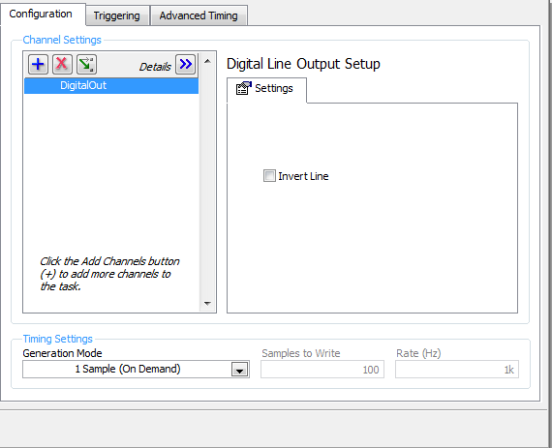
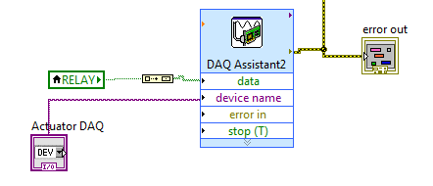
DAQ-6009
For actuation, use the digital out pins
This will output a 5V DC signal when the “data” input is true
Use this for the linear actuator
Paintball hopper control is a bit more complicated, will go into detail later

Slide 15
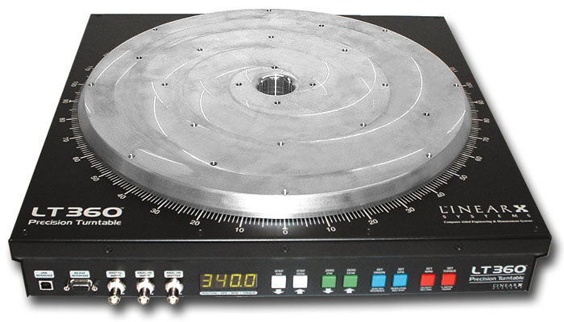
Automation – Turntable
The turntable is a LinearX Systems LT360EX
Wired using a dedicated RS-232 cable (very reliable)
LT360 software is very self explanatory

Slide 16
Automation – Turntable
The platter has a bit of wobble in it so there is a large diameter rotational bearing attached on the same horizontal plane
The rotational bearing stabilizes/levels using four thumb screws that connect to an 8020 frame
All of the 8020 connected directly to the turntable is precision leveled/drilled
Take care if modifying

Slide 17
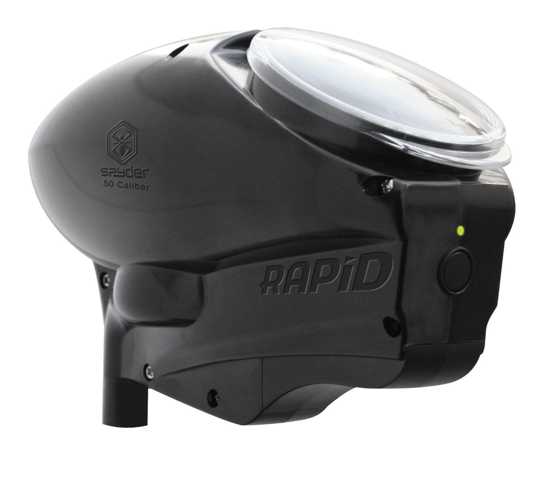
Automation – Paintball Hopper
http://www.amazon.com/Spyder-Paintball-9-Volt-Rapid-E-Loader/dp/B003BT2EUQ

Slide 18
Automation – Paintball Hopper
Take the paintball hopper apart and you will find three main components:
DC motor (two wires)
Flex sensor at the output barrel (two wires)
Circuit board with the above two attached
Disconnect the motor and flex sensor from the circuit board, and remove the circuit board
You can wire the motor and sensor directly to the DAQ-6009
You will want to connect the motor to a 9V power supply (you can use a phone charger or any other DC source) through an H-Bridge, which will be controlled by the DAQ
The DAQ-6009 will then be able to control (on/off/direction) the paintball motor
Using the sensor is optional. It is a flex-resistive sensor that will change resistance when a ball exits the hopper

Slide 19
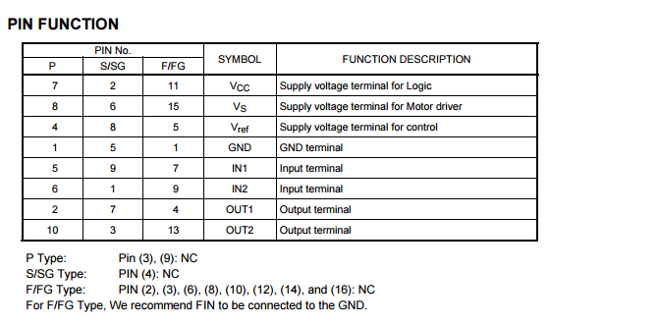
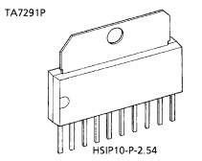
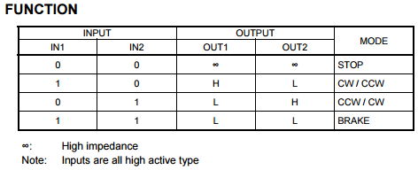
Automation – Paintball Hopper
Here is the Toshiba H-Bridge schematic that we have used in the past:
5V from DAQ
9V from power source
5V from DAQ
Ground from DAQ + power source
DAQ digital output #1
DAQ digital output #2
Motor lead #1
Motor lead #2
Pin #10
Pin #1
sequential
http://www.toshiba.com/taec/components2/Datasheet_Sync/200706/DST_TA7291P-TDE_EN_3604.pdf

Slide 20
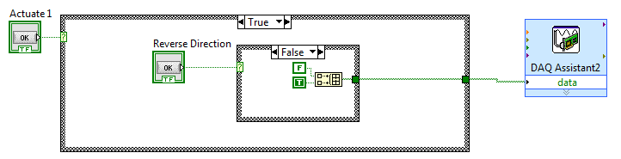
Automation – Paintball Hopper
Here is how the LabVIEW VI translates to paintball hopper actuation:
Switches F/F (off)
to T/F or F/T (on)
Switches T/F to F/T
(on-fwd to reverse)
Sends a two-element array to DAQ
Outputs motor mode

Slide 21
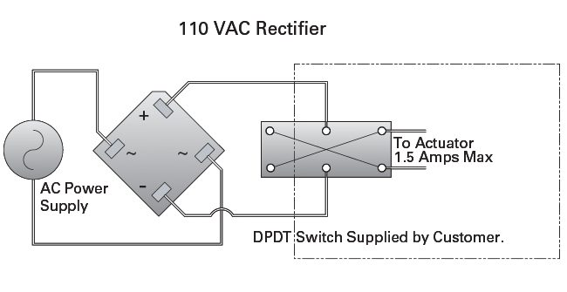
Automation – Linear Actuator
The linear actuator is a simple DC motor (Nook Industries CC-18-HD E linear rod style actuator)
Powered by a DC-Rectified wall socket power source
ON/OFF controlled using a relay switch
Speed controlled using a dimmer switch (common to household lights)
Direction controlled using a DPDT switch
IF REWIRING THE ACTUATOR, UNPLUG FROM POWER SOURCE!!!
Relay
Controlled
by DAQ-6009
Dimmer
Switch
Fuse
110V DC Rectifier

Slide 22
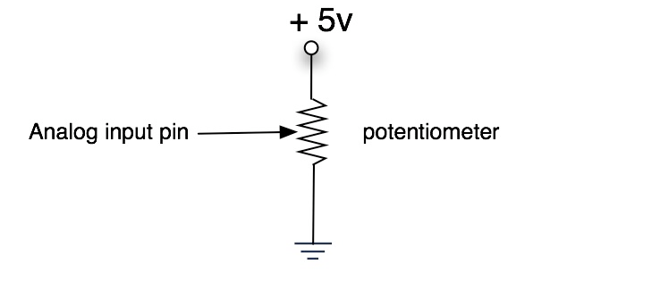
Automation – Linear Actuator
The linear actuator has a built in potentiometer that interfaces with one of the worm screws
The wires should never need to be disconnected from the actuator. They will need to be connected and reconnected from the DAQ-6009 often. Here’s how they should be connected to the DAQ:
Red wire -> 5V
Black wire -> GND
White wire -> AI (zero usually)

Slide 23
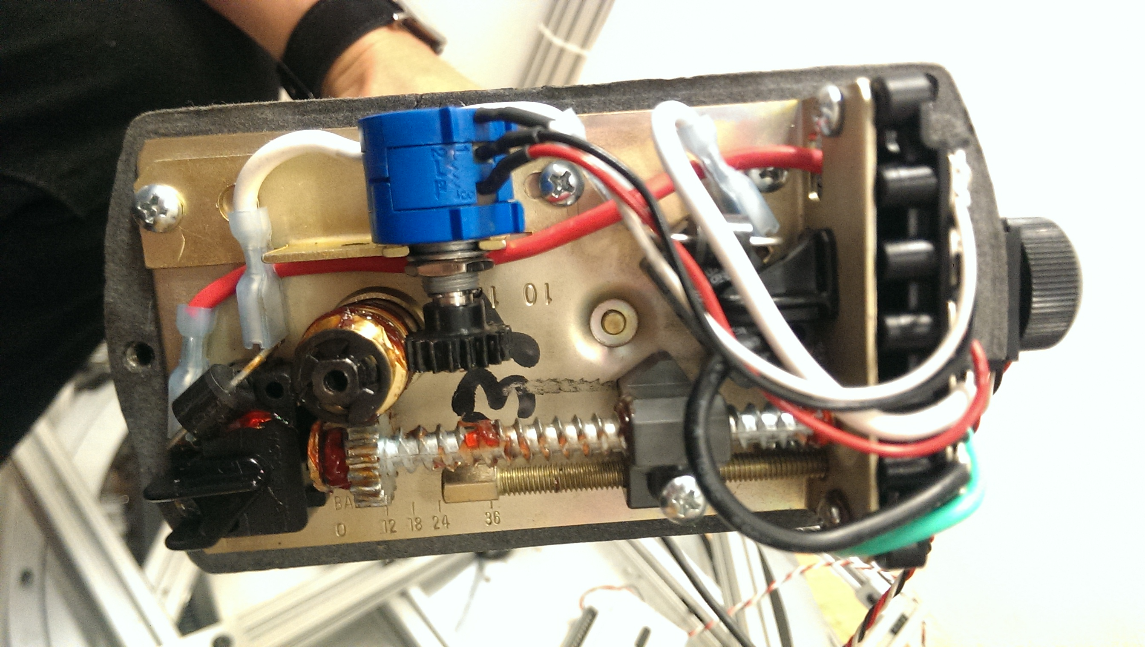
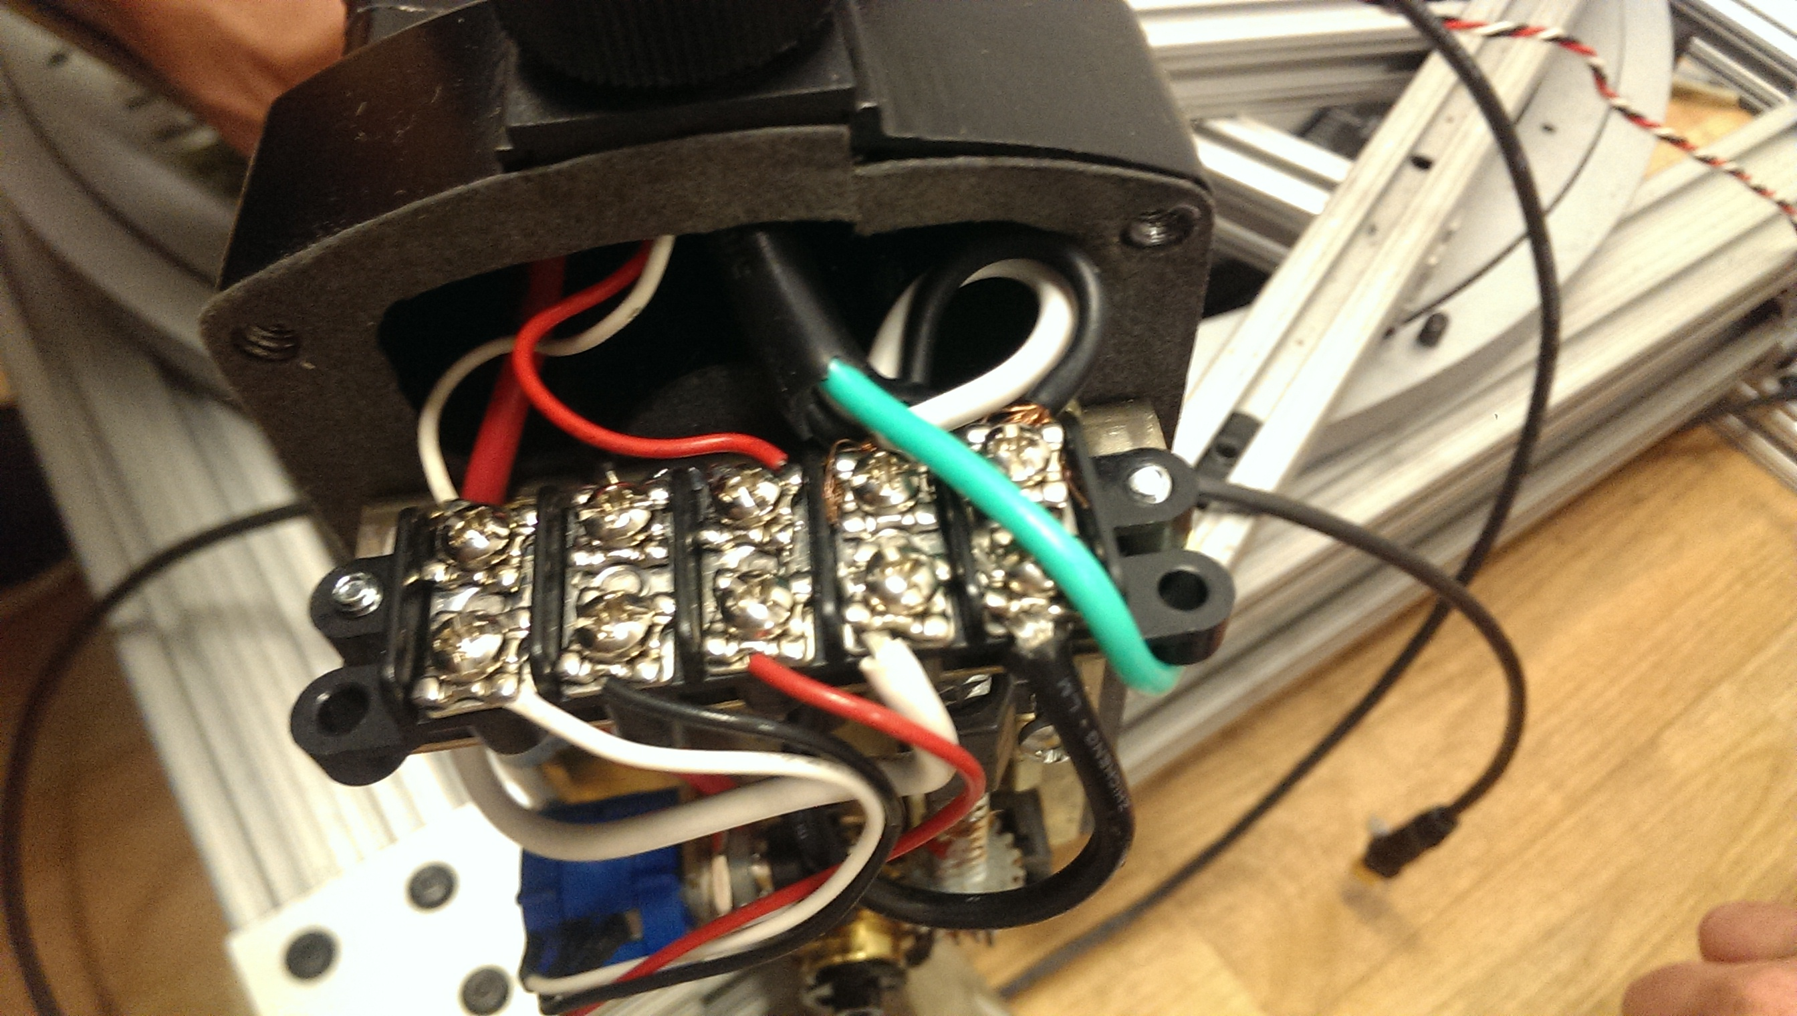
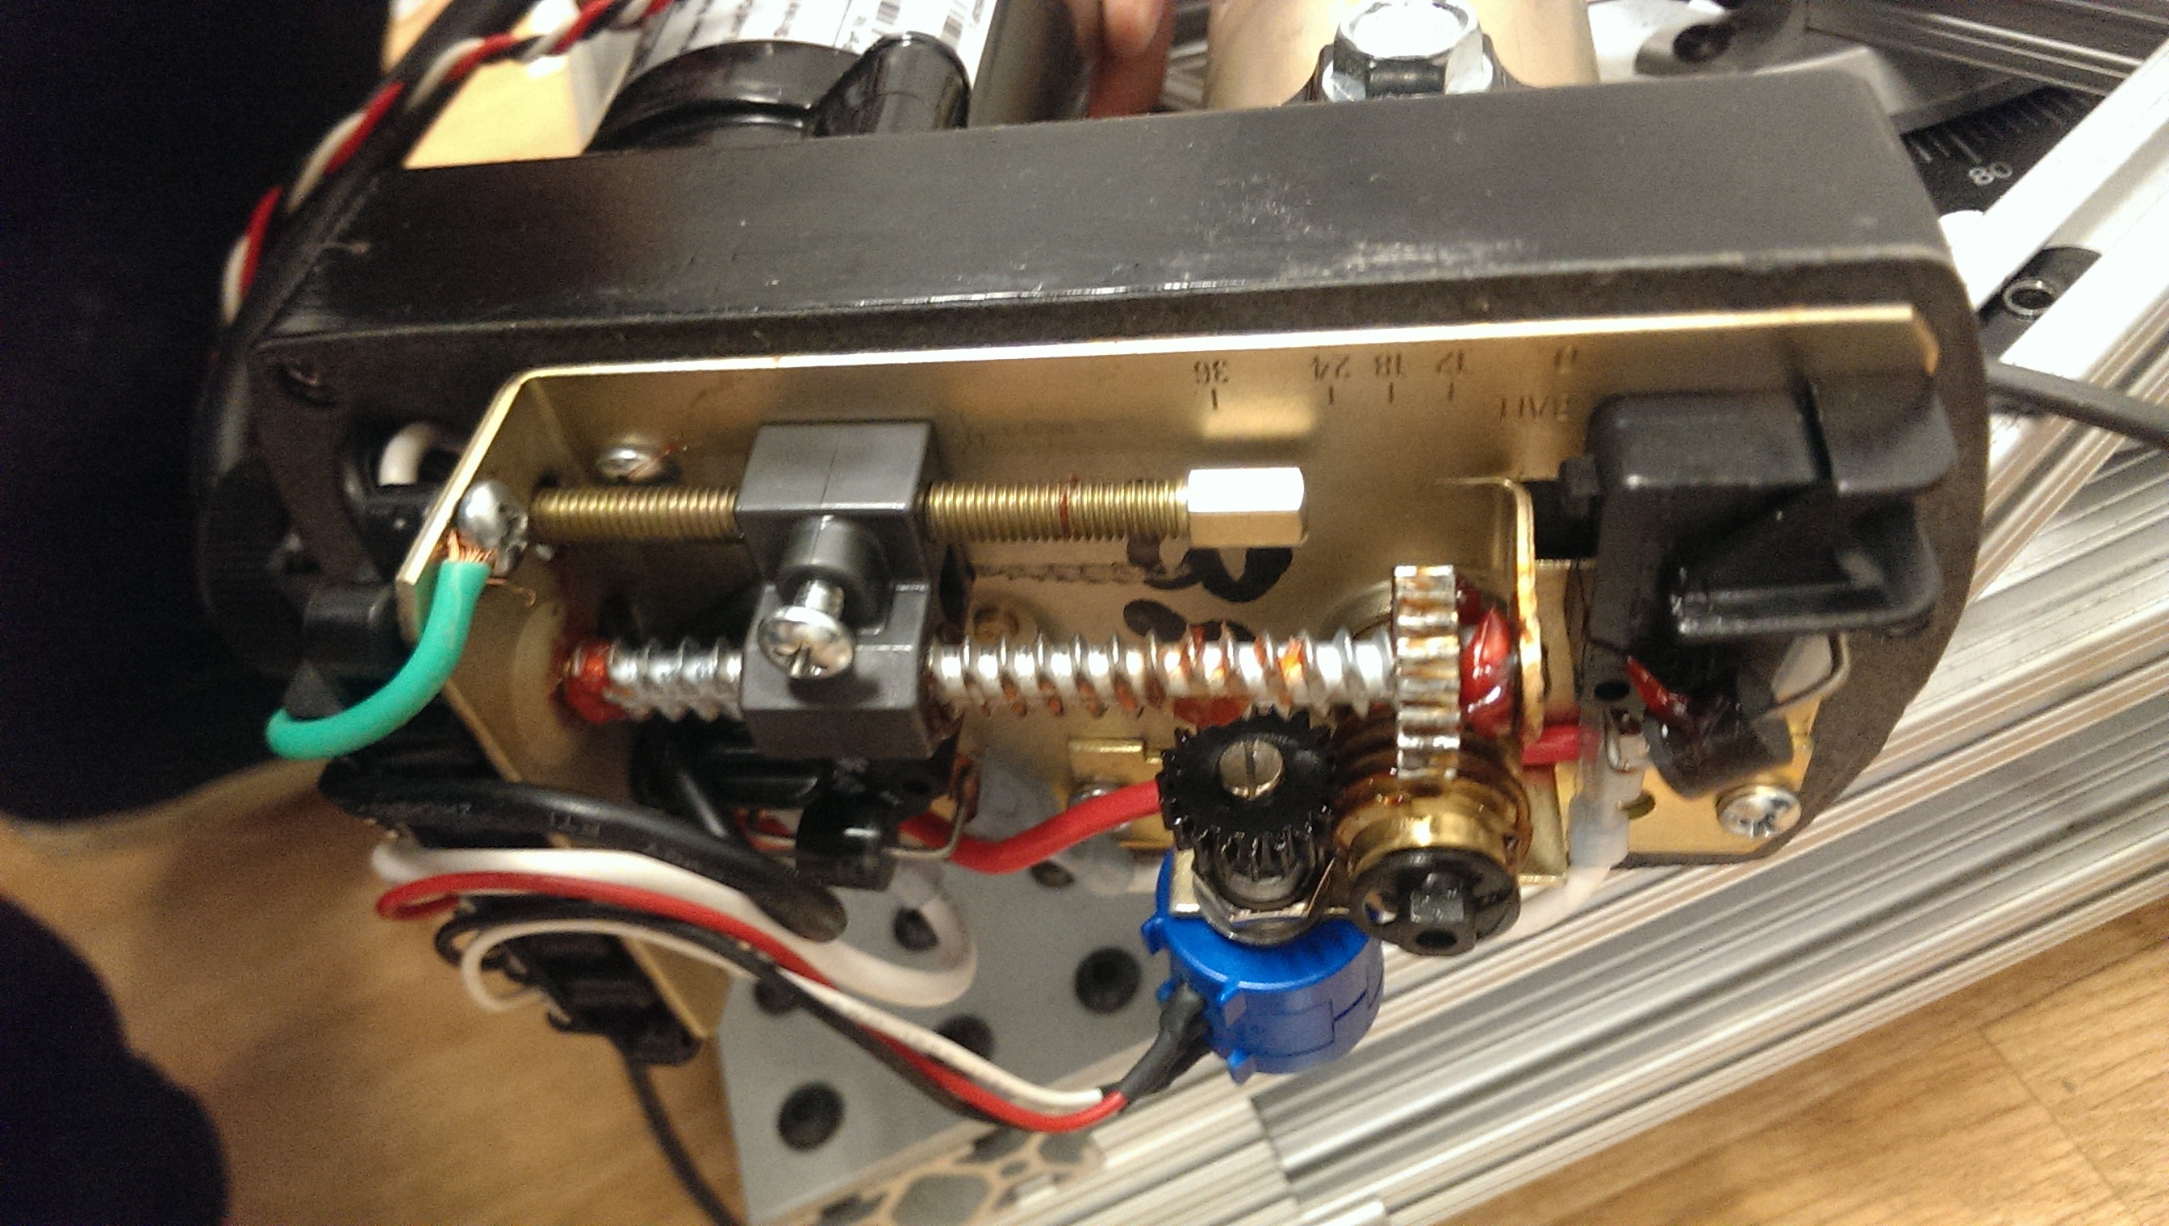
Automation – Linear Actuator
Here is what the wiring looks like when the bottom cover of the actuator is taken off:
Potentiometer
White/Black/Red wires
From DAQ-6009
(connect to: AI/ground/5V)
Black/White wires
From power source
(connect to DPDT)
Ground
(green)
Ground
(from wall outlet
ground to
actuator housing)
White/Black/Red wires
from Potentiometer
(connect to: AI0/ground/5V)
White/Black wires
from DC actuator motor

Slide 24
Automation – Linear Actuator
Interfacing with LabVIEW
Make sure “SET MODE” is set the same as the DPDT switch
You can set a reference location and move the actuator to that reference
You can also add a given step size to the reference
Reset throw distance will set your current location to a user-set value (zero the location or otherwise)
USE THE SET LIMIT
Set in relation to the test section
Prevents the actuator from extending/retracting too far and breaking your experiment!

Slide 25
Automation – Linear Actuator
Interfacing with LabVIEW
The deadband is a distance measurement
The actuator will turn off when within the deadband distance from the reference
Should typically be set to ~0.07 inches

Slide 26
Automation – Linear Actuator
Interfacing with LabVIEW
The LabVIEW VI saves the locations of the actuator over your runtime
Clear and erase data whenever you can
Otherwise, the saved data gets passed through the program every cycle and will start to slow down the program after a long time

Slide 27
Automation – Linear Actuator
The linear actuator works pretty well for step sizes down to ¼” and even 1/8”. Precision is proportional to step size.
If necessary, a good upgrade would be to get a DC motor controller capable of outputting PWM signals
This would give precision control of the speed, and would also allow for a precision feedback system
Asking CIET people about their variable speed drives may be useful
For more on PWM control: http://www.allaboutcircuits.com/textbook/semiconductors/chpt-11/pulse-width-modulation/

Slide 28
Installation Procedures
The 80/20 schematics should be posted on the internal XPREX wall and should be sufficient to build any necessary test stands
The linear actuator must be uninstalled when building the cylindrical silo test setup
The +, - and GND wires must be disconnected from the actuator by removing the actuator’s lower cover and unscrewing the terminals
Always remember what went where (use tape to mark)
The wires are then removed through the center of the turntable
The potentiometer leads should remain connected to the actuator, disconnect at the DAQ-6009
Threading wires through the center of the turntable can sometimes be difficult
A good trick is to tie small 24 gauge hookup wire to the cables that need to go through the turntable center
The 24 gauge wire is much easier to work with, and much easier to get through the turntable center
The use of hooks and pliers is encouraged

Slide 29
Installation Procedures
To move the x-ray detector:
This is a two person job
Have a person on either side of the detector, each with an 80/20 hex screwdriver
Loosen one bolt at a time, while supporting the detector weight on both sides
One bolt is actually sufficient to hold up the detector, once the last bolt is loosened, the detector will be free to slide (and to fall, be careful!)
Slide the detector to the desired height and tighten a single bolt
Use a precision level before you tighten a 2nd bolt such that a bolt is tight on either side with the detector VERY level
A level detector is critical for digital tomography
This is worth spending an extra 10 minutes on to get perfect

Slide 30
Installation Procedures
To move the x-ray collimator:
This is a two or three person job
(or just have James do it, he’s strong)
The collimator is much heavier than the detector
One person on either side with screwdrivers supporting weight with an (optional) third person supporting weight in the middle is ideal
A procedure similar to the detector is used, except:
Precision level is not as necessary, as the actual collimator can rotate
When you get the collimator to the ideal height, lock it down and just level the rotating part of the collimator

Slide 31
Best of luck and always feel free to contact Grant Buster
720-495-6245
grant.buster@gmail.com

